Slide 1

A Glance at Scrum-agile
Kerrian Offermann
CS250: Module Seven

Slide 2
Scrum Team Roles
Product Owner
Scrum Master
Development Team
(Overeem 2016)

Slide 3

Product Owner
The product owner takes the visions of customers and stakeholders, and turns them into different missions for the team to accomplish. These "missions" are known as the product backlog. The product owner is important because they create and make the major decisions for the product backlog such as which item takes priority over another (Cobb 2015).
This Photo by Unknown Author is licensed under CC BY-SA-NC

Slide 4
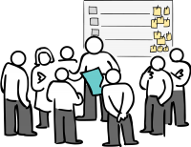
Scrum Master
Scrum Masters serve as guides in all things Scrum for their organization and team. They are sometimes referred to as "Servant Leaders“ (Overeem 2020) because they both lead and support their team when it is necessary. The Scrum Master is important because they are there to help with roadblocks, organize daily meetings, and aid the development to complete their sprints and increments. (Schwaber & Sutherland 2020)
This Photo by Unknown Author is licensed under CC BY-SA-NC

Slide 5

Development Team
The development team is composed of developers, testers, and anyone else that works on the product itself. It is the job of the development team to self organize and determine the best approaches to completing sprints, reaching out to Product Owners and Scrum Masters whenever guidance is needed. The development is important because they are the ones who actually create the product and test its quality before submitting it as "done”. (Overeem 2016)
This Photo by Unknown Author is licensed under CC BY-SA-NC

Slide 6
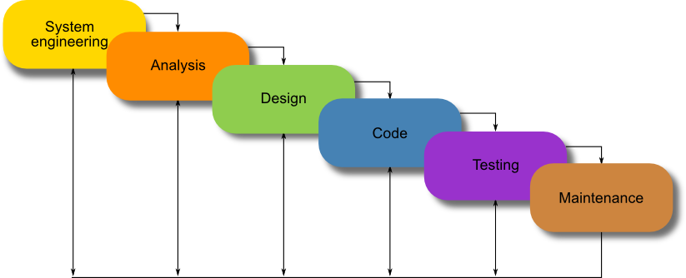
The Waterfall Method
The waterfall method is described as a linear, sequential method with a goal at each phase of development (Cobb 2015). The greatest difference between agile and the waterfall method is certainty. Waterfall avoids unexpected changes while agile embraces it.
The SNHU Travel Project would have been a lot different with the waterfall method. The request to change from a list of destinations to a slideshow, for example, would mean having to jump from the coding phase back to the design phase which the waterfall method does not allow. With waterfall, planning needs to be done when it’s time to plan, designing needs to be done when it’s time to design, etc. In short, the waterfall method would not have worked well with the SNHU Travel Project due to the fact that changes were requested later on.
This Photo by Unknown Author is licensed under CC BY

Slide 7
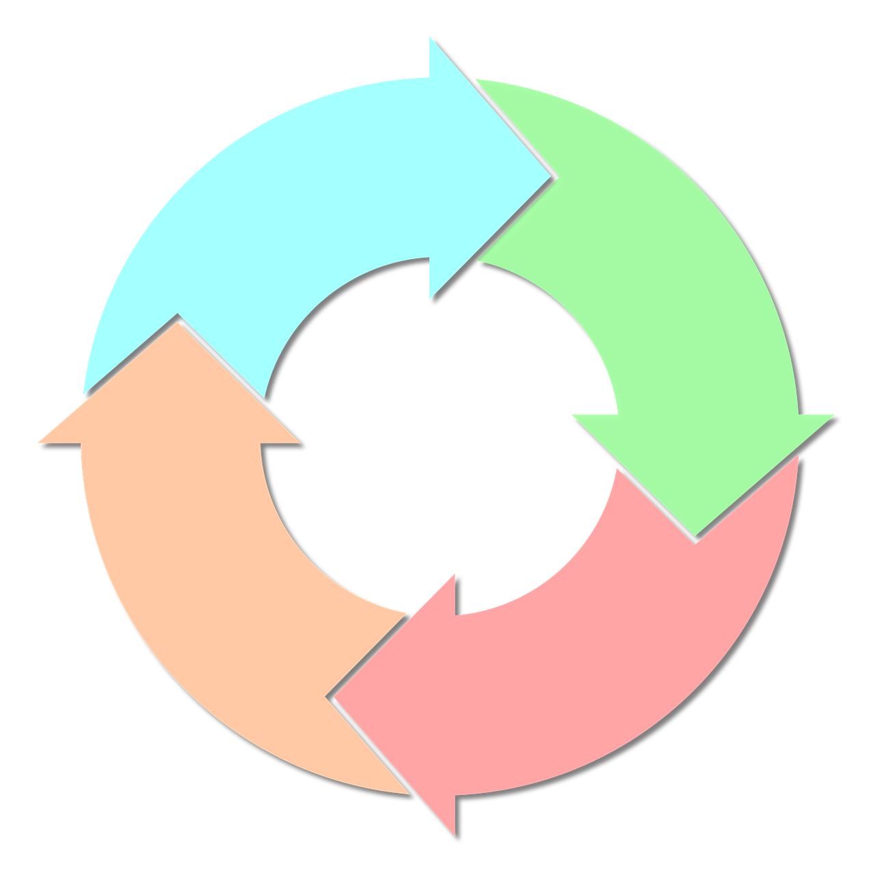
The Phases of SDLC in Agile
Planning: This is the phase where the project begins. In this phase, the Product Owner will work with the client to ensure that their vision can be accomplished and provide an estimate of everything from the time to the cost. This phase is important because the things planned in this phase will serve as the foundation for the project.
Analysis: This is the phase where the Product Owner builds the team that will work on the product backlog. This phase is important because providing the right people and right tools for the job is essential for making the upcoming sprints productive.
Development/Iteration: This is the phase where sprints happen and development begins. The Scrum team will tackle the product backlog with the development team building the product while the Scrum Master arranges daily meetings and offers support to ensure there are minimal problems. This phase is important because it is not only the bulk of the project, but it is where the product becomes a tangible thing.
Testing: This phase involves comparing the current product to the requests in user stories, and checking for any flaws left behind by the developers. Since this phase is essentially quality assurance it is extremely important. A final product riddled with flaws can hurt the company’s reputation.
Production: Once testing is complete, the next phase is production. This is where the final product is delivered, and the Scrum Master can offer a review and retrospective. This phase is important because there are valuable lessons to be learned at the end of a project, and looking back on it can prevent issues in future projects.
Maintenance: The final phase in the SDLC in Agile is maintenance. This involves continuously making sure that the product is up to standard and up to date. This phase is important because it is important for the client to see the company as reliable, and it is important for the company to uphold their promise of a working product.
(Cobb 2015)

Slide 8
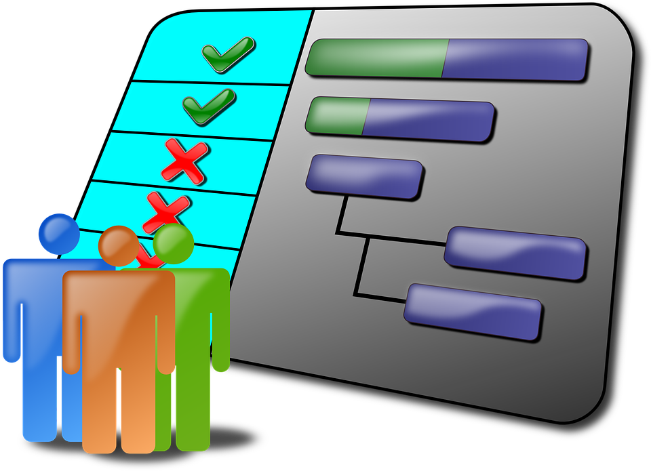
Waterfall VS Agile
When it comes to choosing the waterfall method or the agile method, factors to consider are flexibility and the importance of sticking to a plan. From my experience throughout this course, the more complex a project is the more likely it is that agile would be best. Meanwhile, a simple project that does not require a lot of editing and revisiting can be accomplished with the plan-friendly method of waterfall.
When it comes to projects like the SNHU Travel site where designs are likely to change throughout the process, a method like agile works well. Meanwhile, when it comes to personal tasks like assignments, for example, it is better to use the waterfall approach where going through different phases until the deadline is more efficient.

Slide 9
References
Cobb, C. (2015). The Project Manager’s Guide to Mastering Agile : Principles and Practices for an Adaptive Approach. Wiley.
Overeem, B. (2016). Characteristics of a Great Scrum Team. Scrum.org. Retrieved December 8, 2021, from https://www.scrum.org/resources/characteristics-great-scrum-team-0.
Schwaber, K. & Sutherland, J. (2020) The Scrum Guide. The Scrum Guide. Retrieved December 8, 2021, from https://scrumguides.org/docs/scrumguide/v2020/2020-Scrum-Guide-US.pdf

